Slide 1

The What and Why of
WordPress Security
Paul Gilzow

Slide 2
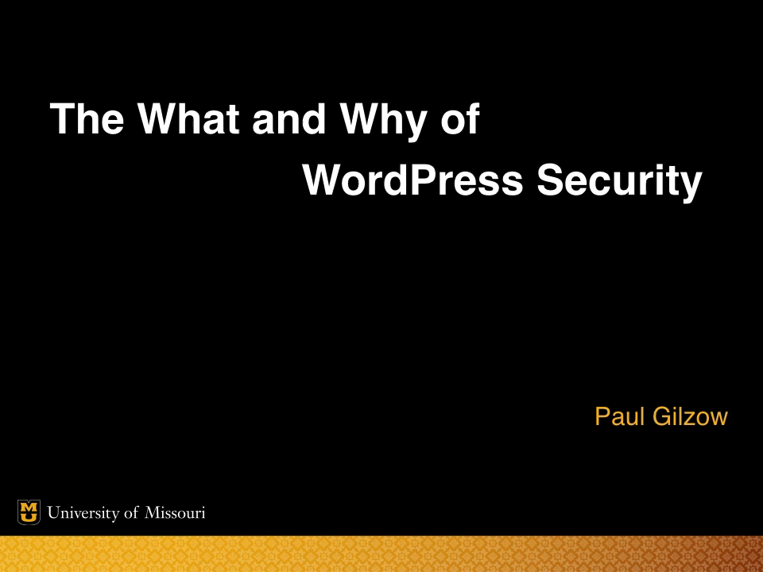
Notes:
From an NSA security education program in the 50s, 60s and 70s

Slide 3
The What and Why of
WordPress Security
Paul Gilzow

Slide 4
The What and Why of
WordPress Security
Make sure to submit questions during this presentation via Twitter. Use the hashtag #WPCampus and @gilzow (me). You’ll earn points toward the conference game for each question you submit!

Slide 5
The What and Why of
WordPress Security
Make sure to submit questions during this presentation through the WPCampus website! You’ll earn points toward the conference game for each question you submit!
https://2018.wpcampus.org/schedule/security-chat-for-everyone/

Slide 6

Language Explanation
Internet Engineering Task Force RFC 2119’s verbiage for indicating requirements
MUST and MUST NOT indicate non-optional requirements
SHOULD and SHOULD NOT indicate recommendations for which exceptions may exist
MAY indicates truly optional requirements

Slide 7
TL;DR
Minimizing Risk

Slide 8
What is “Risk”?
Risk is the intersection of assets, threats, and vulnerabilities.
Asset
People, Property, Information
An asset is what we are trying to protect
Threat
Anything that that represents a potential danger to an asset, whether deliberately or by accident
A threat is what we’re trying to protect against
Vulnerability
Weakness or holes/gaps in security procedures or program that can be exploited by a threat to affect assets
Notes:
mention threat agent

Slide 9

What is “Risk”?
Asset = You
Threat = Rain
Vulnerability = Hole in your umbrella
Risk = you getting wet

Slide 10
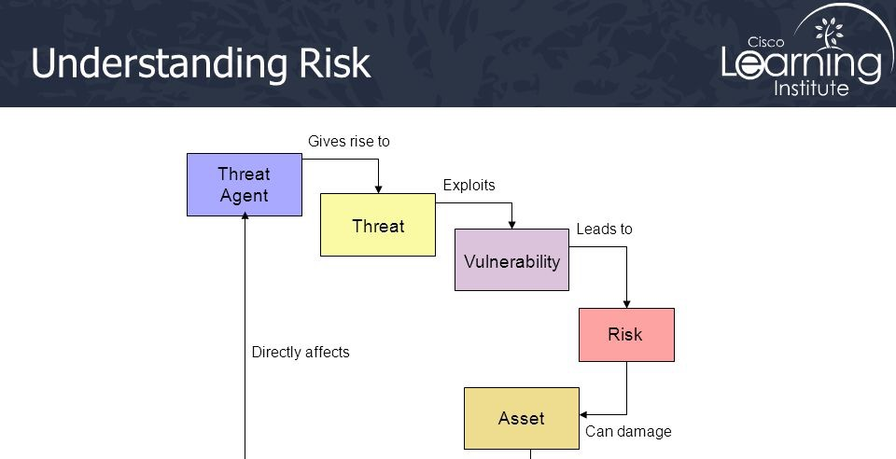
Notes:
threat agent - the entity that identifies a vulnerability and uses it to gain access or affect an asset
A threat agent is the facilitator of an attack, whereas a threat is a category of objects, persons, or other entities that represents a potential danger to an asset.
Exposure - potential to experience losses from a threat agent
possibly skip
Sauce: https://www.slideshare.net/AhmedHabib4/ccna-security-02-fundamentals-of-network-security

Slide 11
What is “Risk”?
The potential for loss, damage or destruction of an asset(s) as a result of a threat exploiting a vulnerability multiplied by the impact of the threat occurring
Notes:
the probability for a threat to occur X the impact of it occurring

Slide 12
What is “Risk”?
OR the likelihood that known threats will exploit vulnerabilities and the impact they have on assets
Risk management is striking a balance

Slide 13
Core Pillars of InfoSec
Confidentiality
Integrity
Availability
Segregation/Isolation of Processes, sandboxing
Principle of Least Privilege
Defense in depth
Plan for failure
Logging
Test/Verify
Trust, but verify
Notes:
Put the risk def in a quote box

Slide 14
Why Education is an Attractive Target
Network bandwidth and availability
Rich in hardware infrastructure
Poor in human resources
Resistant to blacklisting
SEO reputation

Slide 15
Why Education is an Attractive Target
Personally Identifiable Information (PII) / Sensitive Personal Information (SPI)
Protected Health Information (PHI)
Confidential Intellectual Property
Export Controlled Data
National Security Interest (NSI)
Notes:
Export data - Information or technology deemed to be sensitive to national security or economic interests and subject to federal export control regulations as promulgated by the U.S. Departments of State and Commerce.

Slide 16
#1: Backups
What
A snapshot of your
the files that make up your site
database
Why
Notes:
#1 by quite a bit

Slide 17
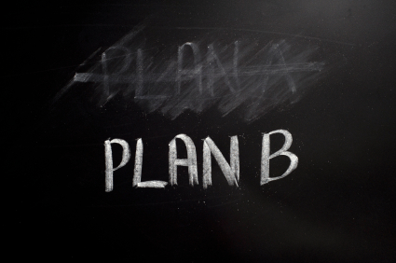
#1: Backups
Notes:
Or simple: Plan for Failure

Slide 18
#1: Backups
What
A snapshot of your
the files that make up your site
database
Addresses two types of threats:
Data loss/damage
Disruption in service/site downtime
How does it reduce risk?
Lowering Impact

Slide 19
#1: Backups
Bonus points
How Often?
What should you back up?
Types of backups
Protection of the backups

Slide 20
#1: Backups
How Often?
Will depend on how much data you’re willing to lose or recreate
If unsure, start with daily backups and adjust from there
What should you back up?
Ideally
contents of the uploads directory
database

Slide 21
#1: Backups
How long should you keep a back up?
Depends on how much data you’re willing to lose or recreate
Start with 3 months and adjust from there
Backups should be in triplicate
Hot backup
Cold backup
Remote cold/long-term backup

Slide 22

#1: Backups
Bonus points
Protect your backups
Don’t keep your back ups in a publicly accessible area
Test your backups!
Notes:
though wordfence _did_ just do a post about backups three days ago: https://www.wordfence.com/blog/2018/07/three-incident-response-preparations-you-should-be-making/

Slide 23
#2: Keep WordPress Up-to-date
Why/How does it reduce risk?
Updates often address security issues
Potentially removes an exploitable vulnerability
How
Don’t turn off automatic minor updates*
Upgrade and stay on the latest branch release*
Security principle : Don’t use components with known vulnerabilities
* Where possible
Notes:
In cases where you can’t update immediately, consider utilizing a web application firewall
because you can never remember: evaluates requests for potential attacks

Slide 24
#3: Strong Passwords
What
Use a password that is long and contains randomized alpha characters, numbers and special characters
Does not contain common words in the dictionary
Why/How does it reduce risk?
More difficult for attackers (threat agents) to guess, and, historically, brute force
Prevent unauthorized access
Notes:
user name/password is the #1 method used for authentication

Slide 25
#3: Strong Passwords
Even more important than complexity is length
3 to 4 additional characters has the same entropy (number of possible combinations) as passwords using a more complex set of characters
Notes:
Show the calculator: https://www.grc.com/haystack.htm

Slide 26
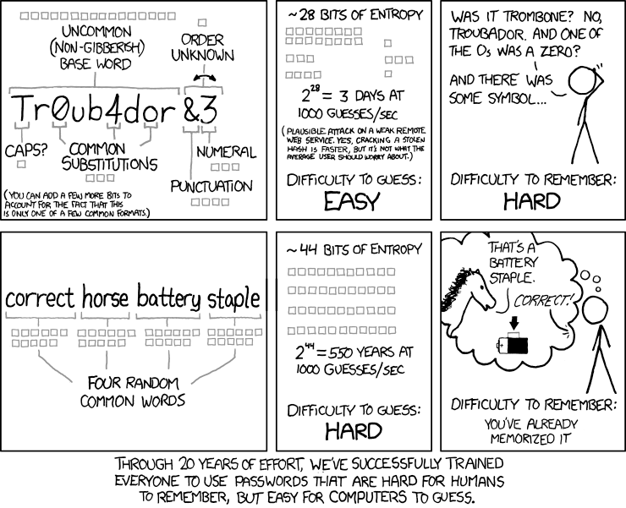
#3: Strong Passwords
https://xkcd.com/936/
Notes:
possibly remove

Slide 27
#3: Strong Passwords
But wait!

Slide 28
#3: Strong Passwords
What if we COMBINE them?!

Slide 29
#3: Strong Passwords
Your new password!
MF>E,D4,C!q^m,uSwVh.[2AD+JHsM^6}
Assuming one hundred billion guesses per second will take 6.22 million trillion trillion trillion centuries to brute force

Slide 30
#3: Strong Passwords
They need to be unique, for every account, on every site
As of 2017, 7 billion credentials have been leaked/exposed
Credential stuffing
Notes:
Mikey mentioned haveibeenpowned yesterday
Show a password brute force using the password with WPScan

Slide 31
#3: Strong Passwords
"R=.b8q%P5(fR74cZd3n<srtE?6c{X%`
$;@(:B&%hY^gt&QHV7t.4}y2:nnED:fe
Ah=4Rp9gb{zb5qW!`:K;5=R6]nDXD'PM
?fF*c,Xk&B<`WsCeeVLPNp{*/n5Nn4bC
ZkD=w{)PKG`<Z8*{)&RdjV{$XZ#L:RnA
7E?#!+5+b){CyM,p@r.U;WW6sFM%%5j"
b-46dy+=V-_Vu-8tU=k.*]Ne%/5k2D#e

Slide 32
#3: Strong Passwords
Use a password manager
No, really: use a password manager
Enforce strong, unique passwords for everyone
Integrate with your institution’s single-sign-on system
Use a strong, unique, and long password everywhere, not just in WordPress
Notes:
Mention lacy’s lightning talk
Mention password padding if they wont/cant use a password manager

Slide 33
#3: Keep Themes/Plugins Up-to-date
Why/How does it reduce risk?
Similar to WordPress core updates, plugin and theme updates can also contain security fixes, removing potential vulnerabilities
Bonus points
Know what you have installed and why you have it installed
Remove those that are no longer in use (#6t)
Limit your plugin/theme use (#13t)
Notes:
patching is difficult, especially the more you have to patch
You can’t protect what you don’t know about
Conversely a threat can’t exploit what isnt there

Slide 34
#4: Hosting Provider
If WordPress is the brain, and your content the heart and soul of your site…
…the hosting provider is the rest of the body

Slide 35
#4: Hosting Provider
Why
Doesn’t matter how well you’ve secured WordPress, if the host is compromised
Remains one of the top vectors for compromised sites
Security principles :
Don’t use components with known vulnerabilities
Establish Secure Defaults / Fail safely
Separation of Duties/Segmentation
Bonus points
Know what your host is running and what versions they have installed
Engage with the team responsible for hosting and work with them to keep the stack up-to-date
Notes:
A good host will eliminate/reduce the number of vulnerabilities, and possibly minimize attack surface area
cross-site contamination
keep the stack up to date (ranked at #14)

Slide 36
#5: Limit Login Attempts
What
Locks an account or blocks an IP address after so many failed attempts
Why/How does it reduce risk?
Threat is unauthorized access
Vulnerability is a weak/common password
Reduces the ability of the threat agent to exploit the vulnerability
Security principle: Minimize the attack surface
Notes:
This is where the lists start to diverge

Slide 37
What is “Attack Surface”?
The sum of all paths for data/commands into and out of the application
Plus all of the code that protects those paths
Plus all of the data used in the application
Plus all of the code that protects this data

Slide 38

What is “Attack Surface”?

Slide 39
#5: Limit Login Attempts
What
Locks an account or blocks an IP address after so many failed attempts
Why/How does it reduce risk?
Slows down an attacker from brute forcing/credential stuffing
Frees up your site resources
Bonus steps
Ensure the plugin you’re using takes into account XMLRPC
Slows down an attacker from brute forcing/credential stuffing
Frees up your site resources
Bonus points
Ensure the method you’re using takes into account XMLRPC

Slide 40
#5: Default Credentials
What
Remove or rename the default “admin” account
Why/How does it reduce risk?
In automated attacks, attackers will typically start with the admin account
Bonus points
Remove account enumeration
Notes:
Tied for #5
One half of the puzzle to logging in
Almost none of the articles mentioned preventing disclosure of user names and even those that did didn’t discuss all the ways user names can be discovered
Not using admin doesn’t buy you much if an attacker can look up your user names

Slide 41
#6: Two/Multi-Factor Authentication
What
Adds a secondary (or multiple) step that must be completed in order to authenticate
Why/How does it reduce risk?
Adds an extra layer of defense against authentication attacks
Security principle: Defense-in-depth
Notes:
Introduce concept of defense-in-depth here
mention that while 2FA/MFA is good, it can be bypassed, especially if they have reused their password for their email account, or how it isnt incredibly difficult to have a phone number moved to a different phone/sim

Slide 42
Defense-in-Depth

Slide 43
#6: File/Directory Permissions
What
Ensure that files and directories are set to the lowest access necessary
Why/How does it reduce risk?
Improper permissions allow an attacker to access restricted files or directories and potentially modify or delete their contents
Security principle : least privilege
Notes:
Dow jones, Viacom, Time Warner, Verizon have all leaked millions of records through improper/misconfigured permissions on Amazon S3 buckets

Slide 44
Principle of Least Privilege
Grant necessary permissions required to perform the intended activities
For a limited time
But with the minimum rights required for the task(s)
Removing permissions when no longer needed
Notes:
Doing so ensures the user/service is unable to perform actions they are not authorized to perform or access data they are not authorized to access
Limits the effects of changes to the area in which they’re made

Slide 45
#6: File/Directory Permissions
Bonus points
Lock down all area of WordPress to read-only except for those areas that specifically require the ability to write
Ideally, only the wp-content/uploads directory is writable, and then only writeable by the php process
If your environment allows it, set files to only readable (0400) by the owner of the process that php runs under

Slide 46
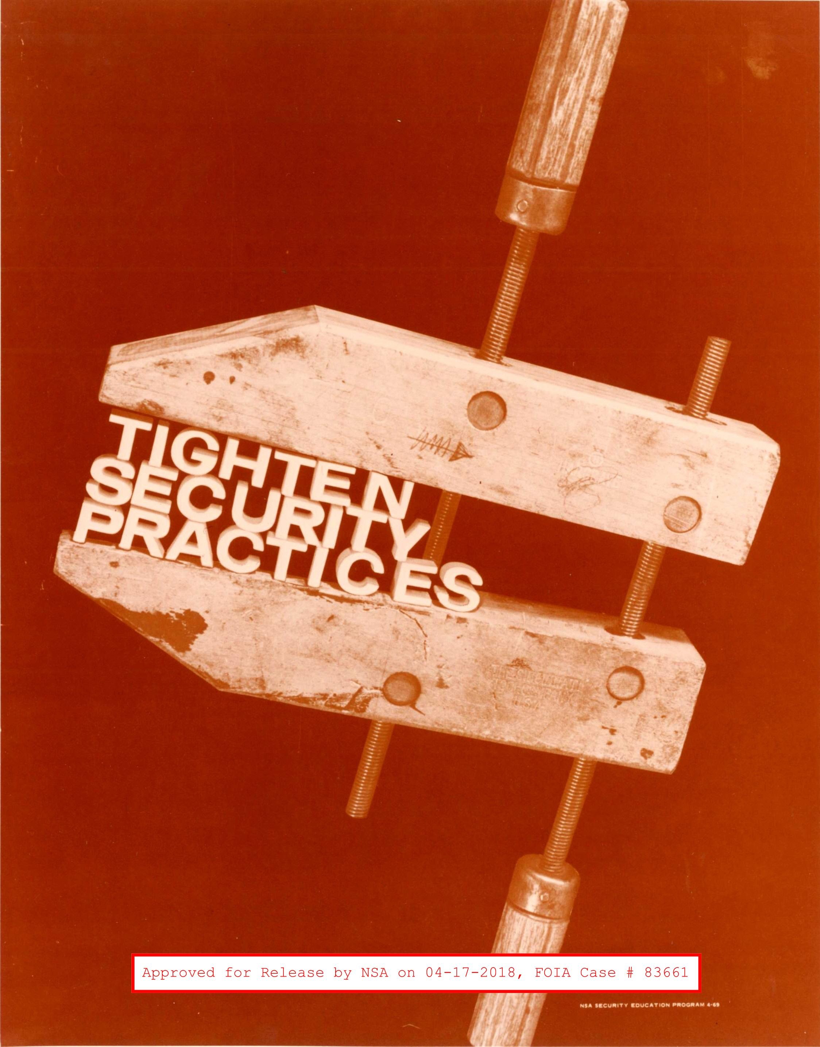
#6:Remove Unused Themes/Plugins/Users
What
Remove everything that isn’t in active use
Why/How does it reduce risk?
Even if a plugin/theme is disabled, the files are still there and are publicly accessible
A non-active user is one more account that can be compromised
Removes potential vulnerabilities
Bonus points
Make plugin, theme and user audits a routine
Notes:
Again, it can’t be exploited if it isnt there.

Slide 47
#7: Protect WP-Config.php
What
Add rules to prevent direct access
move the file somewhere not publicly accessible
Why
Contains your database credentials and salts
Prevents accidental exposure of those assets
Bonus points
Set file permissions to 0400*
See #4 Hosting Provider
Notes:
It is best practice to not store configuration settings in a publicly accessible area
HOWEVER, for this to occur, a minimum of two things need to happen
The web server has to be misconfigured to not invoke the php interpreter for php files (and instead server them as plain text)
During this time, the entirety of your site is going to be completely broken
The web server has to be misconfigured to not block access to the file directly
What this really does is try to protect against an environment misconfiguration
Having the file set to 0400 would have prevented the most recent arbitrary file deletion vuln in 4.9.6

Slide 48
#7: Protect/Limit Access to Login/Admin Areas
What
Add an extra layer of protection to the login area
Basic Access Authentication
Captcha
Why/How does it reduce risk?
Similar to 2FA/MFA in that it adds an extra layer
Security principle: Minimize attack surface and Defense-in-Depth
Bonus points
Limit access to the login/admin areas to specific IP ranges
Notes:
Interestingly, many of the articles that discussed this topic didn’t mention limiting access to, or disabling xmlrpc
xmlrpc uses http + xml for communications
basic auth and passes username+password with each request
XMLRPC system.multicall can be abused to execute multiple methods (up to 1999) inside one http request, with each one testing a user/pass combination
As of 4.4.1 WordPress minimizes the chunksize to 1 if multicall is used drastically reducing the scope of abuse
https://www.saotn.org/how-to-wordpress-protection-from-brute-force-xml-rpc-attacks/

Slide 49
64.85.59.68 —> 64.85.0.0/16
Notes:
~4 billion ip addresses —> 65536 addresses

Slide 52
#7: Protect/Limit Access to Login/Admin Areas
Bonus points
Limit access to the login/admin areas to specific IP ranges
Require users to use a Virtual Private Network
Disable XMLRPC if not in use, or limit access to known network ranges

Slide 53
#7: Limit User Roles
What
Give users the lowest possible role that allows them to complete their tasks
Only login with a higher privileged account when performing actions that require elevated privileges
Security principle: Least privilege
Why/How does it reduce risk?
Minimizes the damage if an account is compromised
Reduces the opportunity for a rogue user to inflict damage
Reduces the opportunity for someone to make a mistake

Slide 54
#7: Limit User Roles
Bonus points
Create or add custom roles that give you the ability to be more granular with permissions
Do routine account audits and remove permissions/roles from accounts that don’t require them
Notes:
Who has admin access and WHY?

Slide 55

#7: Use a Security Plugin
What
Install a plugin that has been designed to implement multiple “best measures”
Why/How does it reduce risk?
Can make it easier to implement multiple security measures
Useful if you’re not comfortable with some of the actions
Auditing, Detection, Prevention
Notes:
Possibly discuss using multiple single-focus vs one all encompassing

Slide 56
#8: Disable File Editing
What
Disable the built-in Theme and Plugin file editor
Why/How does it reduce risk?
Prevents a user from altering Theme/Plugin code from the WordPress dashboard
Security principle: Minimize attack surface
Notes:
required edit_theme role which by default only admin has

Slide 57
#9: Trusted Sources
What
Don’t obtain plugins/themes from unknown sources
Why
Code may have been altered/infected
Notes:
I should make the security pri

Slide 58
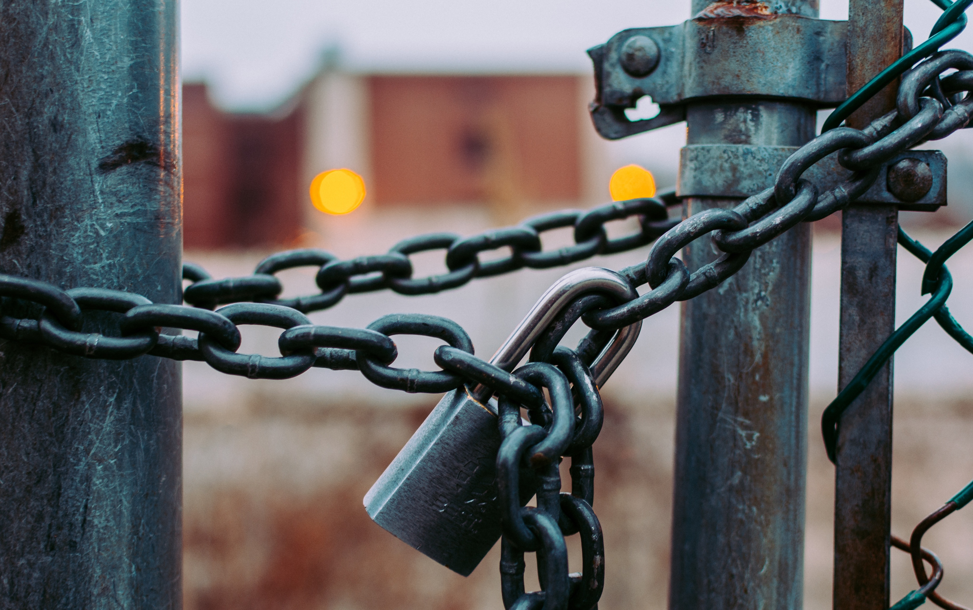
#9: Implement SSL
What
Add a SSL/TLS certificate to your site
Why/How does it reduce risk?
Encrypts the data as it is transferred between your site and the end user
Security principle: Minimize attack surface
Bonus steps
Enforce https over the entire site, not just login areas and wp-admin
Notes:
point them to https://speakerdeck.com/chriswiegman/encrypt-all-the-things-practical-encryption-from-ssl-to-email-and-beyond-2
Is this the correct security principle?

Slide 59
#10: Do Your Homework on Theme/Plugin Selection
What
Research a theme/plugin before installing
Why/How does it reduce risk?
Every piece of code you add to your system increases your attack surface
Every piece of code you add to your system has the potential to introduce new exploitable vulnerabilities

Slide 60
#10: Do Your Homework on Theme/Plugin Selection
“What makes WordPress so insecure is that it's highly extensible and easy to use; wordpress security issues revolve almost entirely around this extensibility and easiness of use.”
Tony Perez, @perezbox
Notes:
Interestingly, many of the articles that discussed this topic didn’t mention limiting access to, or disabling xmlrpc

Slide 61
#10: Do Your Homework on Theme/Plugin Selection
What
Research a theme/plugin before installing
Why/How does it reduce risk?
Every piece of code you add to your system increases your attack surface
Every piece of code you add to your system has the potential to introduce new exploitable vulnerabilities
Security principle: Be paranoid, be skeptical
Notes:
Interestingly, many of the articles that discussed this topic didn’t mention limiting access to, or disabling xmlrpc

Slide 62
#10: Do Your Homework on Theme/Plugin Selection
Jessica Paul, your paranoia is exhausting

Slide 63
#10: Do Your Homework on Theme/Plugin Selection
Security principle: Treat all third party code/data as tainted and hostile
Bonus steps
https://wpvulndb.com/
https://php-grinder.com/
Run third party code through PHP-CS Security Audit
Run local static code analysis
Notes:
Third party code more than likely have differing security policies and posture than you

Slide 64
#11
Web Application Firewall
Move/Hide Login Location
Routine Security Scan
Log actions/activities
Secure your local machine
Notes:
Interestingly, many of the articles that discussed this topic didn’t mention limiting access to, or disabling xmlrpc

Slide 65

Items I believe should be higher in the list
Block PHP execution (#14t)
Logging (#11t)
Segmentation/Isolation (separation of duties)
Be selective with XMLRPC
Remove software/services that aren’t actively used
Limit the number of plugins you use (#13t)
Monitor for file changes (#12t)
Stay informed!
Notes:
only 2 articles mentioned disabling with it, and one mentioned being selective

Slide 66
Summary
Always be thinking in terms of how you can reduce risk
Minimize attack surface area
Principle of least privilege
Defense in depth
Don’t use components with known vulnerabilities
Be paranoid, be skeptical
Treat all third party code/data as tainted and hostile
Security is a continual process; you’re never “finished”

Slide 67
Paul Gilzow
Programmer/Analyst / Security Analyst at the University of Missouri
Contact
gilzow@missouri.edu
@gilzow on twitter
https://http://fb.me/gilzow
https://profiles.wordpress.org/gilzow
Slides: https://github.com/gilzow/whatwhywordpress/

Slide 68
Questions
WHAT QUESTIONS DO YOU HAVE FOR ME?

Slide 69
The What and Why of
WordPress Security
Please be sure to submit session feedback through the WPCampus website. Not only will you earn additional points toward the conference game, you’ll also be entered to win a door prize!
https://2018.wpcampus.org/schedule/security-chat-for-everyone/

Slide 71


